Slide 1
Pastel Body Forms 2
By
Gaille Hunter
Giclees on Canvas 20’x24’
215-982-8145
PO Box 27232, Philadelphia, PA 19118

Slide 2
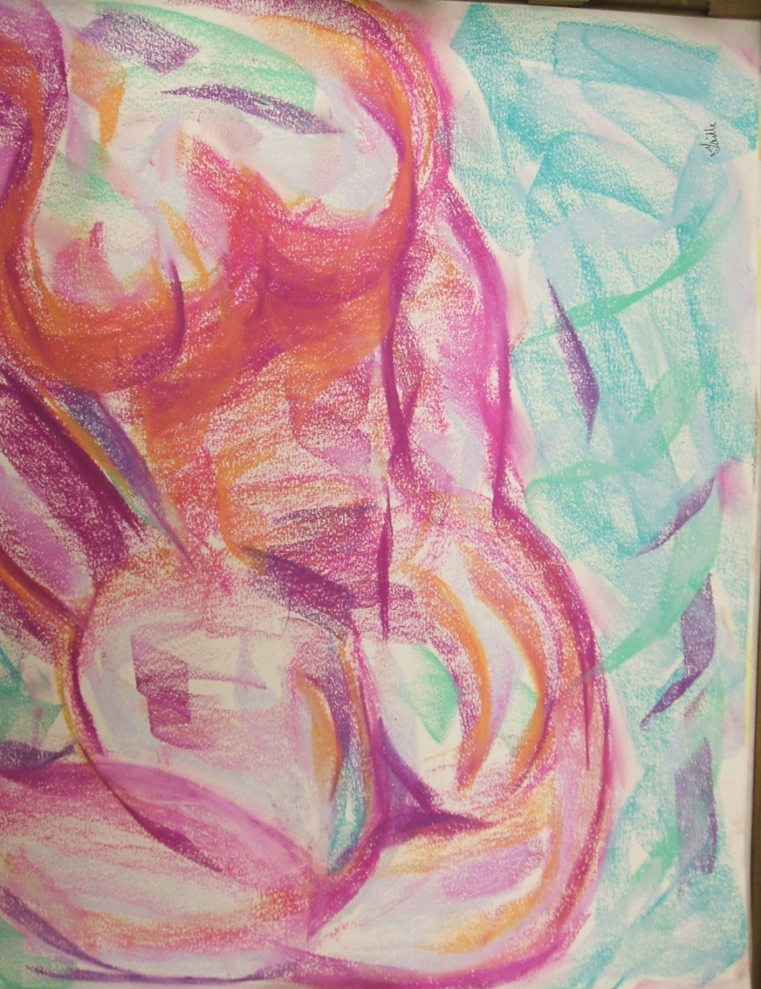
Sunlight Repose

Slide 3
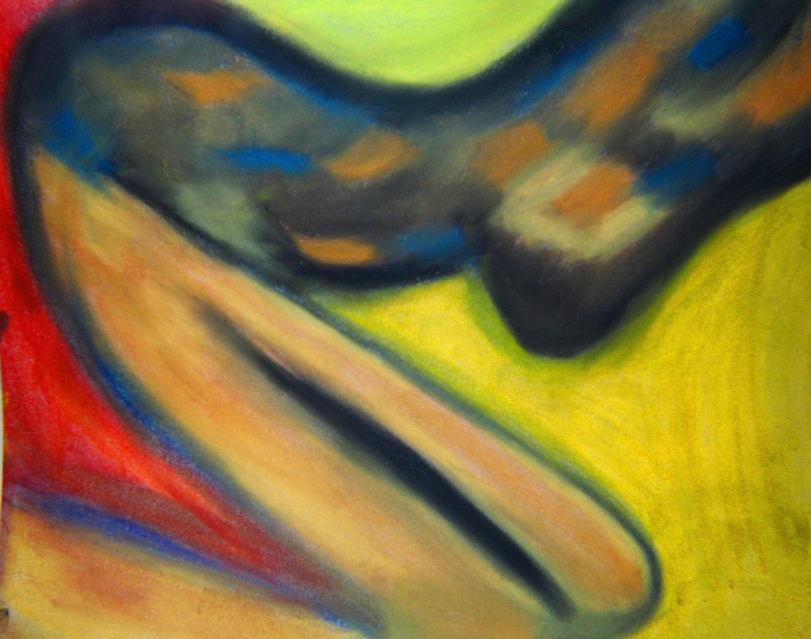
Black & Tan

Slide 4
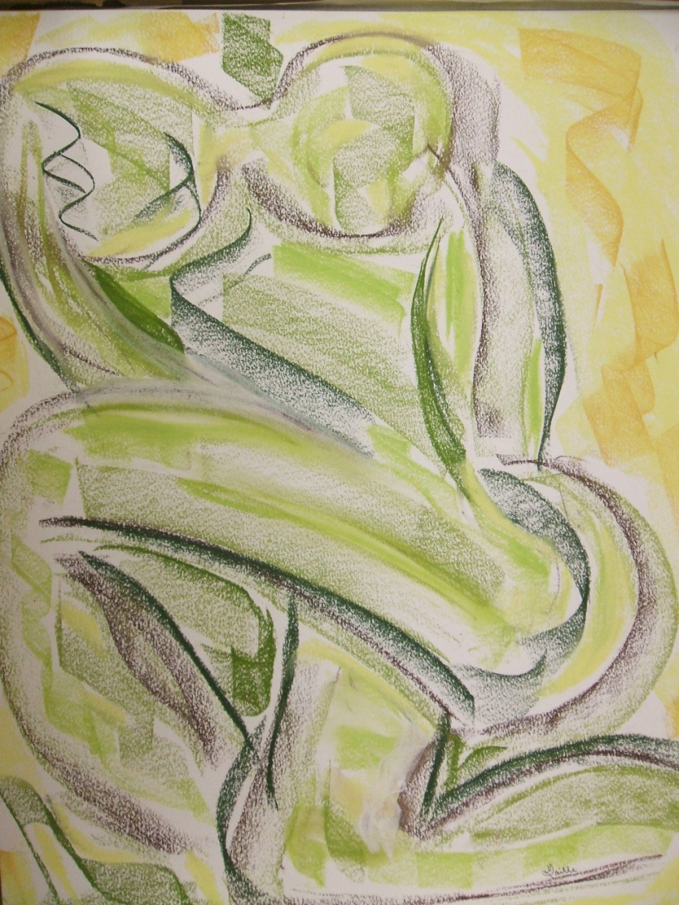
Green Rising

Slide 5
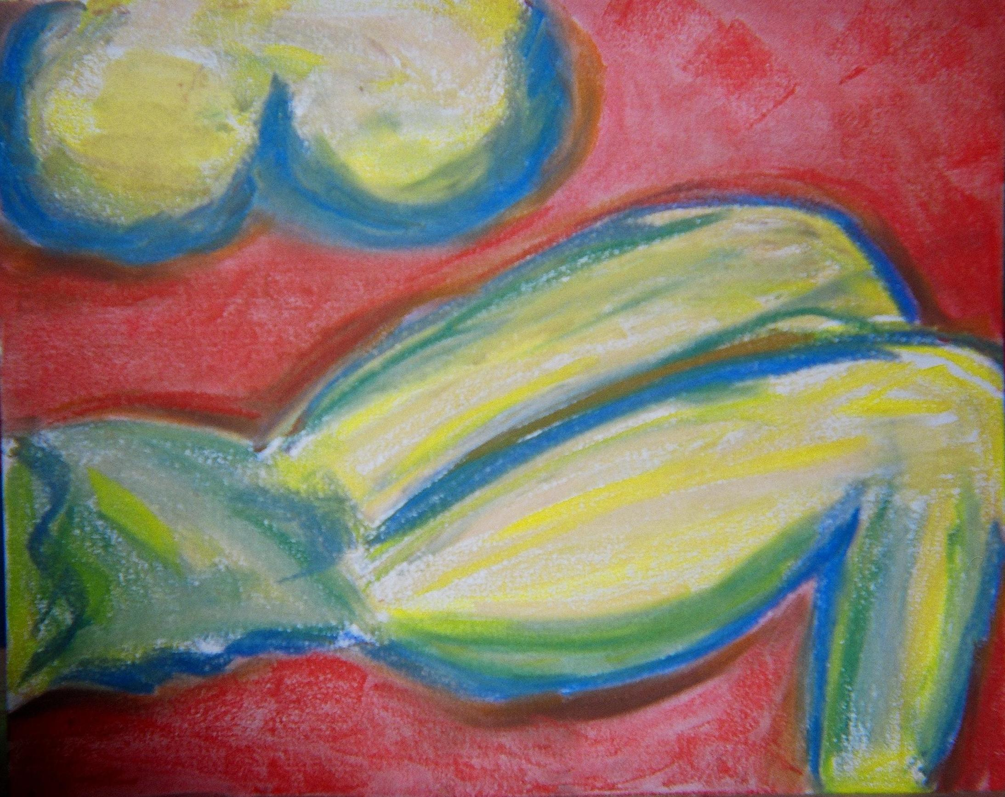
Pablo #1

Slide 6
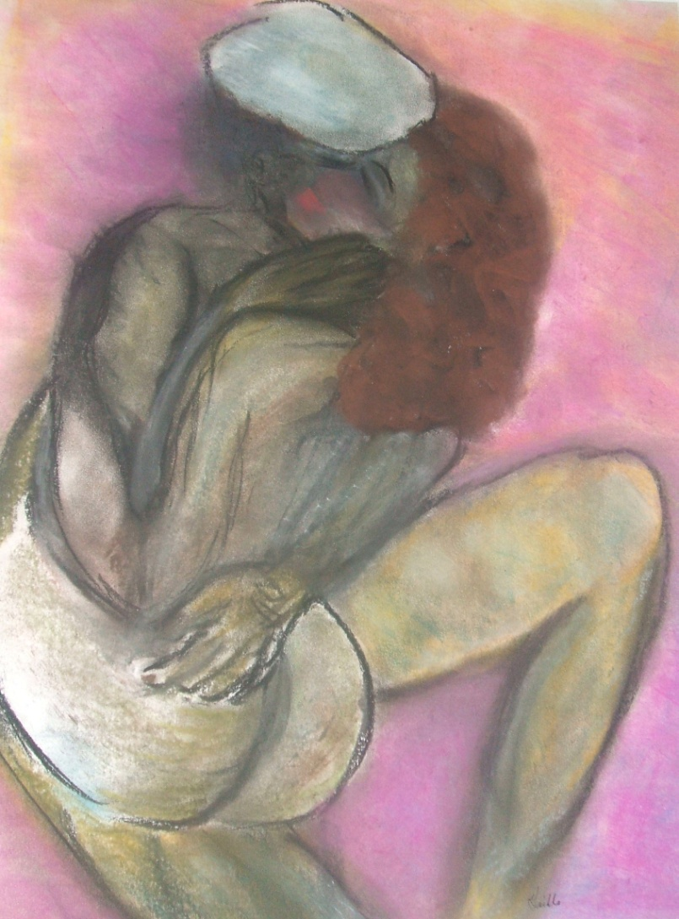
The Kiss #1

